Slide 1
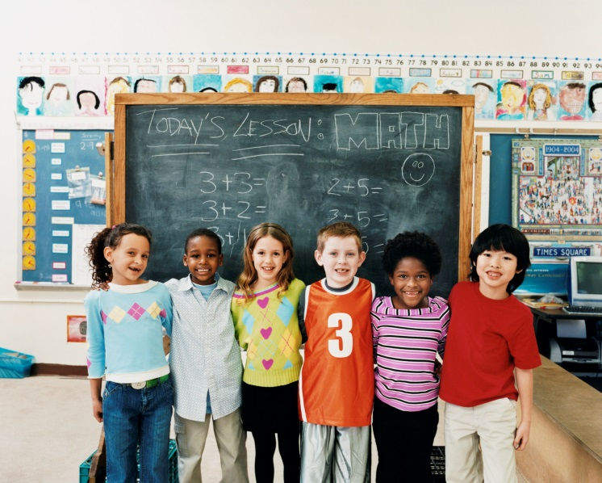
Involving Families Through Social Media
Dr. Tisha Shipley

Slide 2
Traditional Ways Teachers Communicate with Families: 1. Phone Calls 2. Face-to-face 3. Parent Teacher Conferences 4. News letters (notes home) 5. Family Meetings (Parent Meeings) 6.Notebooks (take home daily, weekly) 7. Report Cards 8. E-mail Many of these are one-way communication strategies

Slide 3
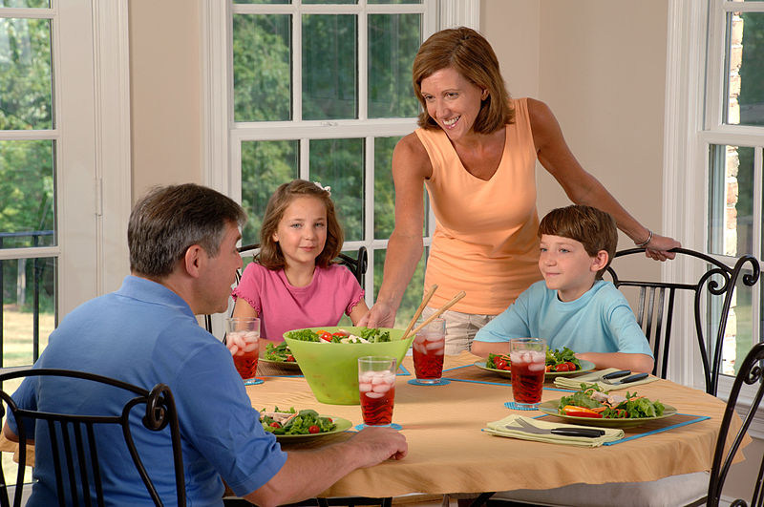
Building Reciprocal Relationships: 1. Building successful partnerships 2.Thoughtful 3. Listen 4. Respectful 5. Genuine Care 6. Open-Ended questioning 7.Understand differences

Slide 4
Classroom Website
My Personal Website:
www.busyclassroom.weebly.com
1.Literacy
2.Math
3.Reading
4.Arts and Crafts
5.Tips and Tricks for students
6.Websites
Website for teachers and families

Slide 5
Teaching Website (Free or pay) Things you may add for families: 1.Homework Page 2. Blog 3. Recipes to Cook at Home 4. Things to Work on At Home 5. Developmental Milestones 6. Important Information (times dates) 7. Things you are working on at school 8.Websites for Famlies (Resources) 9. Websites for children 10. Pictures (if allowed)

Slide 6
Teaching Blog
My Personal Teaching Blog
Ideas, thoughts, feelings, new topics, family issues, healthy recipes, experiences, milestones, how to help children and families, activities you can do with children, websites etc.

Slide 7
Professional Twitter
Early Childhood : Child Development Twitter
Connect with Other professionals
Find new topics and research
Connect with families
Find resources for families
Engaging and new ideas every second

Slide 8
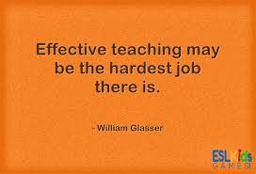
Professional Pinterest
Early childhood Pinterest
Math
Science
Fine Motor
Gross Motor
Children’s Lit
Letters
Bulletin Boards
Cooking Activities

Slide 9
YouTube Channel
Early Childhood YouTube channel
Teaching Ideas
Teaching Concepts
Make and Takes
What you can do for parents
Teach concepts (things they may not understand-one to one correspondence)
Share Your thoughts and ideas
Read books-children can watch

Slide 10
Traditional Ways of Communication New Ways of Communication Why? Comments Ideas Thoughts Ways To Involve Families Through Social Media

Slide 11
Toddler's Creed I want it, It's mine If I give it to you and change my mind later, It's mine If I can take it away from you, it's mine If I had it a little while ago, It's mine If it's mine, it will never belong to anybody else, no matter what. If we are building something together, all the pieces are mine. If it looks just like mine, it is mine. -Anonymous

